Slide 1

Checkpoint 3: Design
Group Members:
Aidan Heffron
Blake Lun
Shifan Hirani
Grant Shields
Josef Munduchikaral
TA:
Brady Testa
Professor:
Pauline Wade

Slide 2
01
02
03
Data Design
Structural Design
Functional Design

Slide 3
01
Data Design

Slide 4
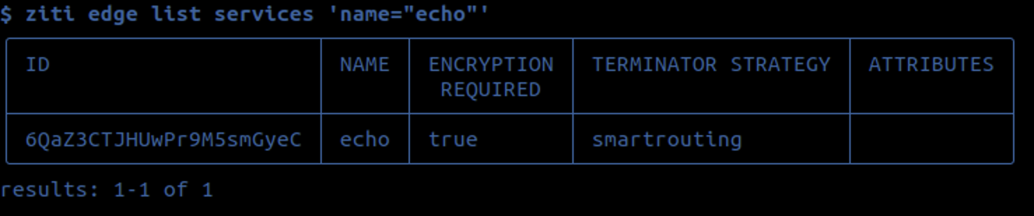
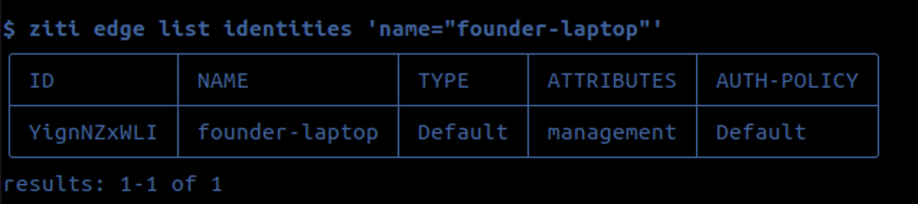
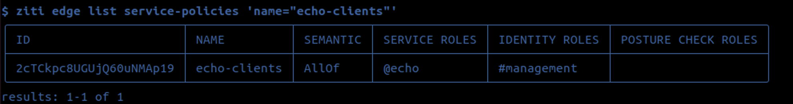
Services register with Ziti, creating a “service” data point
Services use “terminators” when talking with clients
Clients register an “identity” when communicating with services
Services give identity access rights called “policies”

Slide 5
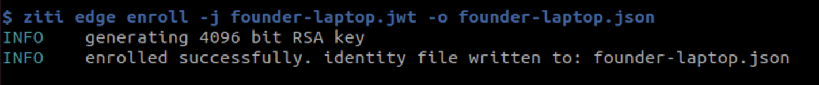
**Currently RSA → switching to PQ**
Key Storage:
{
ztAPI: “”,
ztAPIs: null,
configTypes: null,
Id: {
key: “keyString”,
cert: “certString”,
ca: “caString”
}
}
Provided is an example of our key storage as a .json file →
Related connections (optional)

Slide 6
02
Structural Design

Slide 7
Component Diagram
OpenZiti Platform
Overlay Mesh Network
End-to-End Encryption SDKS
Private Authenticated SDKS
PQC Module
Quantum-Resistant Algorithm
Hybrid PQC mechanisms
PQC Key Management
Zero Trust Components
ZTNA (Network Access)
ZTHA (Hosted Applications
ZTAA (Access Architecture)
Performance Module
Benchmarking Tools
Performance Metrics
Classical vs PQC Comparison
User Experience Module
UX Optimization Techniques
User Feedback Integration
Performance Impact Minimization

Slide 8
Openssl Toolkit OQS Provider
GNU License as well as a Hybrid license structure.
MIT License (less restrictive than Apache)
Both are owned and controlled by the some organization.
Both have implementations of BIKE, CRYSTALS-Kyber, FrodoKEM, and HQC.

Slide 9
Open Quantum Safe Provider
OQS Provider is under the MIT license
OQS Provider repository provides access to multiple algorithms on the NIST list
We can implement the ability for services to choose their preferred encryption algorithm
OQS provider has better licensing than Openssl toolkit
Link to Repo

Slide 10
CRYSTALS-KYBER
Selected for standardization in round 3 of the NIST PQC standardization project
Official Implementation is under Apache License:
Various forked implementations
Will be the first implementation focus

Slide 11
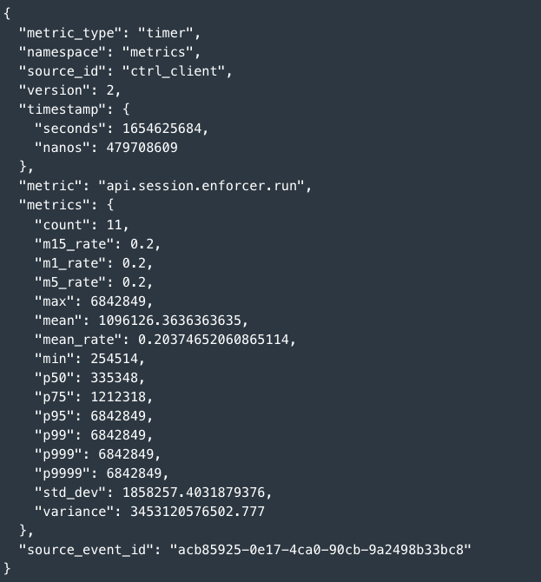
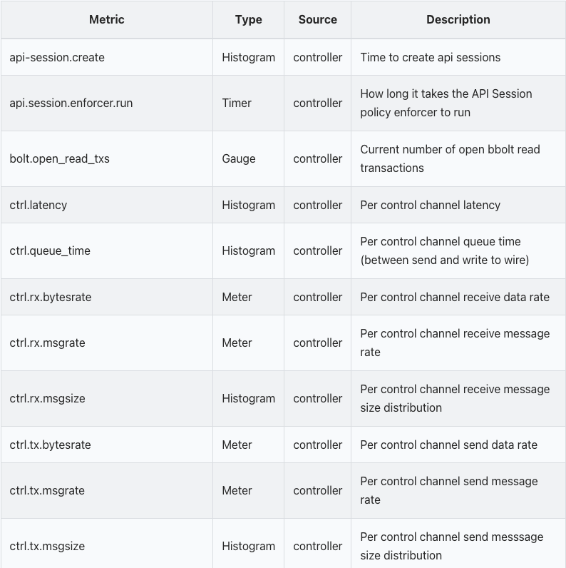
Performance Module

Slide 12
Performance Benchmarking with Ziti and Mininet
Ziti uses iPerf3 for performance benchmarking, focusing on throughput and latency.
Ziti uses smart routing to adapt to the additional latency or processing time introduced by PQC algorithms
Mininet can create complex network topologies on a single machine, allowing for accurate testing of network performance under various conditions
Deploying different PQC algorithms on various nodes with the Mininet topology to study behavior under diverse network conditions
Brief Setup
Configure Ziti endpoints to utilize PQC algorithms for initial key exchanges and ongoing communications
Design a Mininet topology that mimics real-world network scenarios where PQC might be most beneficial, such as cross-continental data links with varying latency and bandwidth characteristics
Notes:
Utilize iPerf3 for conducting 60-second bi-directional performance tests to measure throughput and latency.
Use Mininet to generate network traffic that simulates PQC-encrypted data flows, including the larger packet sizes and potentially different traffic patterns associated with PQC algorithms.

Slide 13
03
Dynamic Design

Slide 14
Overall Ziti Flow
1.
Client Enrolls
2.
Authentication
3.
Authorization
(part 1)
4.
Authorization (part 2)
5.
Connect to Edge Router
6.
Edge Router Evaluates Credential
7.
Client Requests service Connection
8.
Edge router coordinates connection

Slide 15
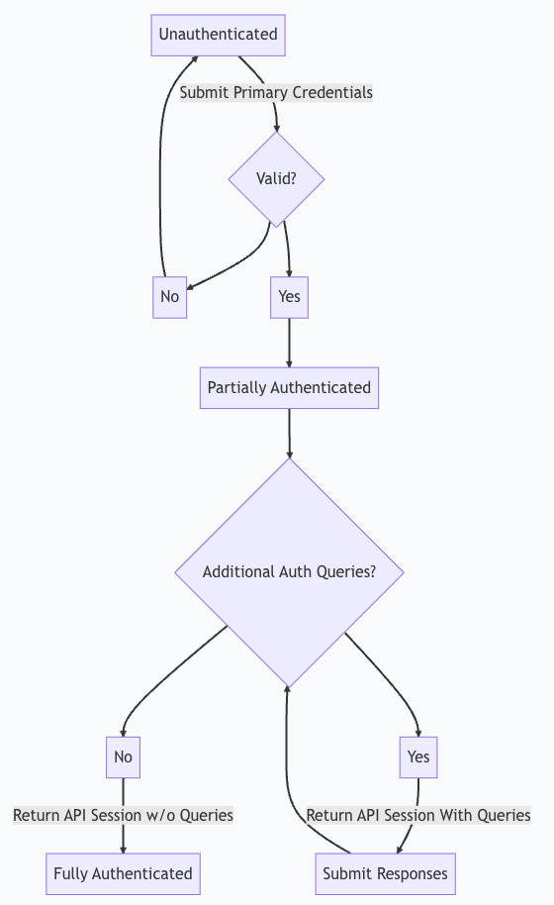
Authentication
Injection of OQS

Slide 16
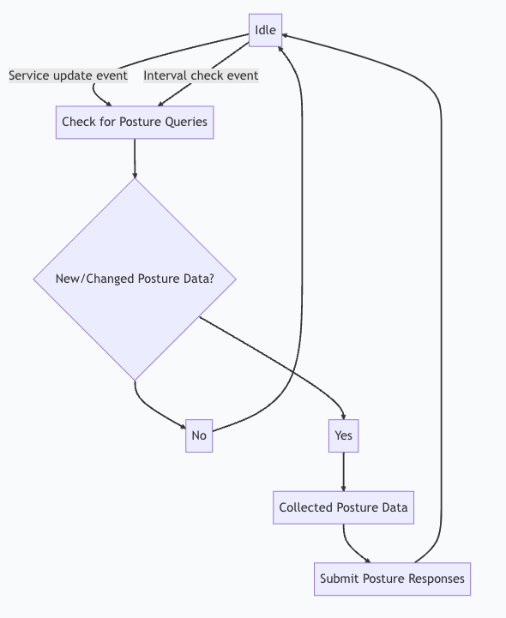
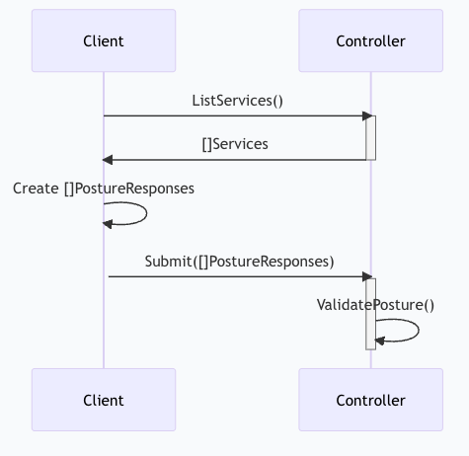
Authorization

Slide 17
Questions?

